Slide 1
Computer System Overview
Chapter 1

Slide 2
Operating System
Exploits the hardware resources of one or more processors
Provides a set of services to system users
Manages secondary memory and I/O devices

Slide 3
Basic Elements
Processor
Main Memory
  referred to as real memory or primary memory
  volatile
I/O modules
  secondary memory devices
  communications equipment
  terminals
System bus
  communication among processors, memory, and I/O modules

Slide 4
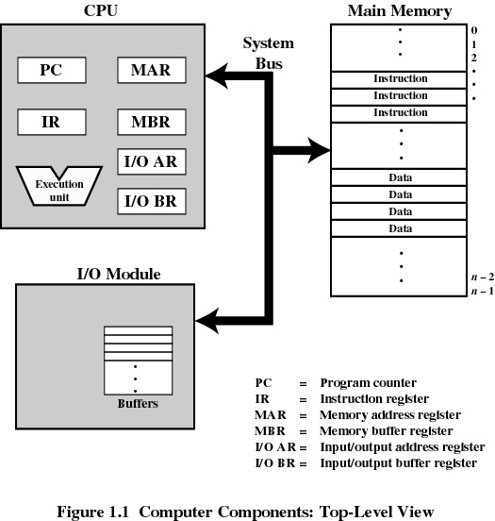
Top-Level Components

Slide 5
Processor Registers
User-visible registers
  Enable programmer to minimize main-memory references by optimizing register use
Control and status registers
  Used by processor to control operating of the processor
  Used by operating-system routines to control the execution of programs

Slide 6
User-Visible Registers
May be referenced by machine language
Available to all programs - application programs and system programs
Types of registers
  Data
  Address
    Index
    Segment pointer
    Stack pointer

Slide 7
Control and Status Registers
Program Counter (PC)
  Contains the address of an instruction to be fetched
Instruction Register (IR)
  Contains the instruction most recently fetched
Program Status Word (PSW)
  condition codes
  Interrupt enable/disable
  Supervisor/user mode

Slide 8
Control and Status Registers
Condition Codes or Flags
  Bits set by the processor hardware as a result of operations
  Can be accessed by a program but not altered
  Examples
    positive result
    negative result
    zero
    Overflow

Slide 9
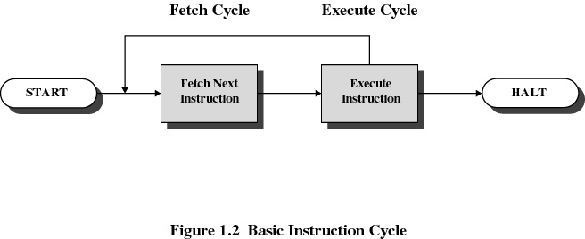
Instruction Cycle

Slide 10
Instruction Fetch and Execute
The processor fetches the instruction from memory
Program counter (PC) holds address of the instruction to be fetched next
Program counter is incremented after each fetch

Slide 11
Instruction Register
Fetched instruction is placed in the instruction register
Types of instructions
  Processor-memory
    transfer data between processor and memory
  Processor-I/O
    data transferred to or from a peripheral device
  Data processing
    arithmetic or logic operation on data
  Control
    alter sequence of execution

Slide 12
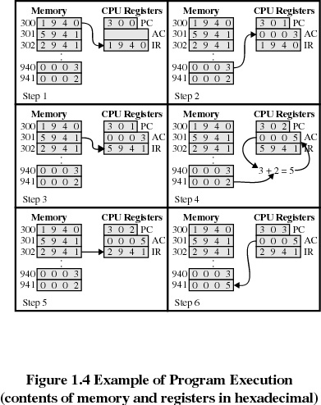
Example of Program Execution

Slide 13
Interrupts
An interruption of the normal sequence of execution
Improves processing efficiency
Allows the processor to execute other instructions while an I/O operation is in progress
A suspension of a process caused by an event external to that process and performed in such a way that the process can be resumed

Slide 14
Classes of Interrupts
Program
  arithmetic overflow
  division by zero
  execute illegal instruction
  reference outside user’s memory space
Timer
I/O
Hardware failure

Slide 15
Interrupt Handler
A program that determines nature of the interrupt and performs whatever actions are needed
Control is transferred to this program
Generally part of the operating system

Slide 16
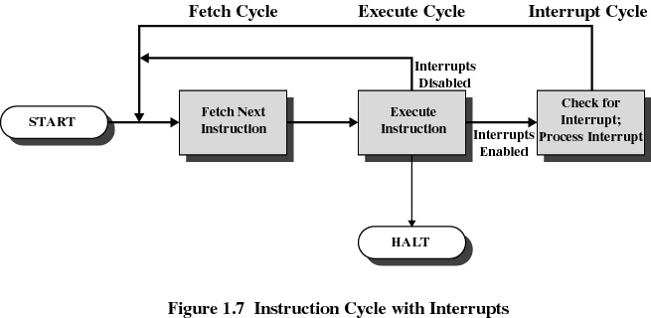
Interrupt Cycle

Slide 17
Interrupt Cycle
Processor checks for interrupts
If no interrupts fetch the next instruction for the current program
If an interrupt is pending, suspend execution of the current program, and execute the interrupt handler

Slide 18
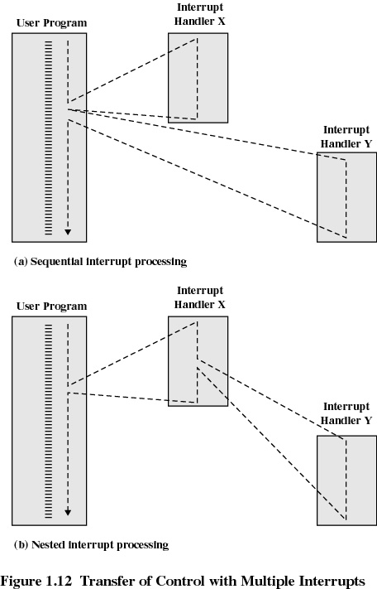
Multiple Interrupts
Disable interrupts while an interrupt is being processed
Interrupts remain pending until the processor enables interrupts
After interrupt handler routine completes, the processor checks for additional interrupts

Slide 19
Multiple Interrupts with Priorities
Higher priority interrupts cause lower-priority interrupts to wait
lower-priority interrupt handler can be interrupted
Example when input arrives from communication line, it needs to be absorbed quickly to make room for more input

Slide 20
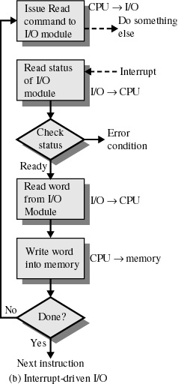
Interrupt-Driven I/O
Processor is interrupted when I/O module ready to exchange data
Processor is free to do other work
No needless waiting
Consumes a lot of processor time because every word read or written passes through the processor

Slide 21
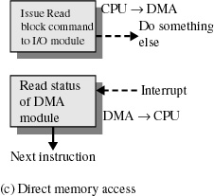
Direct Memory Access
I/O exchanges occur directly with memory
Processor grants I/O module authority to read from or write to memory
The processor is only involved at the beginning and end of the transfer. An interrupt is sent when the task is complete
Relieves the processor responsibility for the exchange. Processor is free to do other things

Slide 22
Multiprogramming
Processor has more than one program to execute
The sequence the programs are executed depend on their relative priority and whether they are waiting for I/O
After an interrupt handler completes, control may not return to the program that was executing at the time of the interrupt

Slide 23
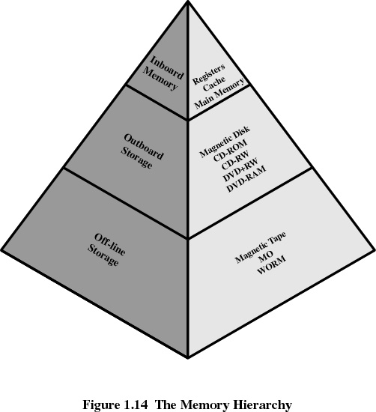
Memory Hierarchy

Slide 24
Going Down the Hierarchy
Decreasing cost per bit
Increasing capacity
Increasing access time
Decreasing frequency of access of the memory by the processor

Slide 25
Cache Memory
Invisible to operating system
Processor speed is faster than memory speed. Therefore, Increase the speed of memory
Contains a portion of main memory
Processor first checks cache
If not found in cache, the block of memory containing the needed information is moved to the cache

Slide 26
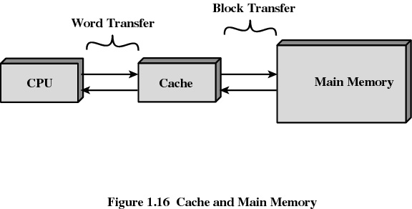
Cache Memory

Slide 27
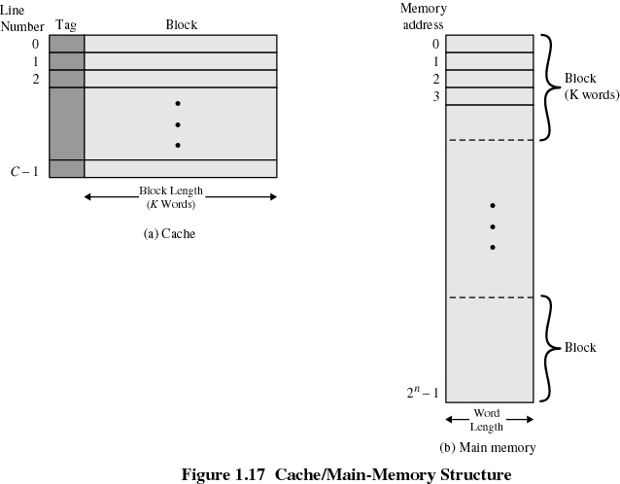
Cache/Main Memory System

Slide 28
Cache Design
Cache size
Block size
  the unit of data exchanged between cache and main memory
  hit means the information was found in the cache
Mapping function
  determines which cache location the block will occupy
Replacement algorithm
  determines which block to replace
  Least-Recently-Used (LRU) algorithm

Slide 29
Disk Cache
A portion of main memory used as a buffer to temporarily hold data for the disk
Disk writes are clustered
Some data written out may be referenced again. The data are retrieved rapidly from the software cache instead of slowly from disk

Slide 30
Initializing the Machine
Power up ⇒ fetch-execute cycle begins
Initial (or hardware) process begins to run
Executes ROM diagnostic program
Then bootstrap loads the OS
OS initialization
  Setup & initialize all system data structures (this creates process & resource abstractions)
  Initialize all devices
  Start daemons – including idle process
  Branches to the scheduler
Notes:
BIOS ABCs
Every computer with a motherboard includes a special chip referred to as the BIOS or ROM BIOS (Read Only Memory Basic Input/Output System). The BIOS includes instructions on how to load basic computer hardware. The BIOS also includes a test referred to as a POST (Power On Self Test) which will ensure that the computer meets requirements to boot up properly. If the computer does not pass the POST you will receive a combination of beeps indicating what is malfunctioning within the computer.
In most PCs, the BIOS has 4 main functions:
POST - Test computer hardware insuring hardware is properly functioning before starting process of loading Operating System. Additional information on the POST can be found our POST / Beep Codes page.
Bootstrap Loader - Process of locating the operating system. If capable OS is located and BIOS passes the control to it.
BIOS - Software / Drivers which interfaces between the OS and your hardware. When running DOS or Windows you are using complete BIOS support.
BIOS / CMOS Setup - Configuration program. Which allows you to configure hardware settings including system settings such as computer passwords, time, and date.

Slide 31
Bootstrapping
Bootstrap loader (“boot sector”)
1
0x0000100
BIOS loader
0x0001000
Fetch Unit
PC
0000100
Decode Unit
IR
…
Primary Memory
Execute Unit

Slide 32
Bootstrapping
Bootstrap loader (“boot sector”)
1
0x0000100
2
BIOS loader
0x0001000
Fetch Unit
Loader
0x0008000
PC
0001000
Decode Unit
IR
…
Primary Memory
Execute Unit

Slide 33
Bootstrapping
Bootstrap loader (“boot sector”)
1
0x0000100
2
BIOS loader
0x0001000
Fetch Unit
Loader
0x0008000
3
PC
0008000
Decode Unit
0x000A000
OS
IR
…
Primary Memory
Execute Unit

Slide 34
Bootstrapping
Bootstrap loader (“boot sector”)
1
0x0000100
2
BIOS loader
0x0001000
Fetch Unit
Loader
0x0008000
3
PC
000A000
Decode Unit
0x000A000
OS
IR
…
Primary Memory
Execute Unit
4. Initialize hardware
5. Create user environment
6. …

Slide 35
Hardware Process Starts
Idle Process
Kernel
ISRs
Process i
Process j
BIOS
Program
Hardware
process
Switch to
another
program

